Slide 1
Modeling Customer Attrition Based on Post-Event Insurance Data
Constanza Schubert IDC 6940 Fall 2019

Slide 2

Motivation
The prolongment of a customer's lifetime value (CLV) is important to remain competitive in insurance industry
Efforts to retain existing customers are less expensive than those to get new customers
Attrition model scores & CLV can be used to prioritize retention efforts and also help develop these strategies
Notes:
Customer attrition models which work well allow the development of strategies to retain and create loyalty in existing customers
Loyal customers – high value high risk, low value high risk
Who is at risk? (identify customers at risk of attrition)
Do we are? What is the value of these customers to the organization (customer lifetime value)
Why are they at risk?
What can we do? Create a set of retention interventions
Would we succeed? Is the intervention likely to change behavior?
Are they likely to leave again soon? How long will this customer then stay. (model re-scoring?)

Slide 3

Background
Mobile Devices
Renters
Connected Living (CL) group is responsible for the protection, repair, refurbishment, and replacement of mobile devices, smart home products, appliances, and electronics
48 million mobile devices connected and protected
Motor Vehicles
Homeowners
Home Appliances & Electronics
Flood
Tools, Jewelry & Furniture
Funeral Planning
Travel & Card Member Benefits
Credit Protection
Notes:
Assurant is a global provider of housing and lifestyle solutions which protect, connect, and supports major consumer purchases
Such purchases include homes, rental properties, vehicles, mobile devices, appliances
electronics, and funerals.
Assurant partners with brands in these spaces to offer insurance products, customer
care claims, technical support, and B2B2C sales support.
Brands in CL: T-Mobile, Apple, Vodafone (B2B), Movistar (Chile), Claro (Brazil), KDDI (Japan)
Connected Living helps keep 48 million mobile devices connected and protected;
along with 80 million appliances, 17 million tools, and 9 million pieces of jewelry and furniture.
Project focuses on predicting attrition for customers of mobile insurance products

Slide 4
Project Goals
Is it feasible to model customer attrition using claim data and achieve actionable results?
Can specific attributes associated with high likelihood of attrition be derived?
Notes:
The aim of this project is to predict the probability of a
customer canceling their policy after a certain period of time after a claim was created by using claim attributes
and possibly text as features, depending on the model performance without text.
What recommendations can be made to improve attrition rates?

Slide 5
Implementation
Data Collection
Exploratory Data Analysis
Feature engineering
Structured data model
Text-based models
Combined model
Feature Importance Analysis
Notes:
A sequential classifier was tested using the larger dataset
Feature selection: Select K Best
Univariate feature selection works by selecting the best features based on univariate statistical tests
--- Compute the ANOVA F-value for the provided sample.
Select features according to the k highest scores.

Slide 6



Data Collection
[DW_DA_USER]
[DW_FORECAST]
[DW_GW]
Post-claim survey responses + claim details
Customer level claims + enrollment details
Zip code level demographics
Emotion lexicons
NRC Emotion
NRC Valence, Arousal, & Dominance
NRC Affect Intensity
[DEMOGRAPHICS_ZIP5]
[VW_AMSDOM_SURVEY_DETAIL] [AMSDOM_CLAIM]
[FACT_ENROLLMENT] [DIM_CARRIER]
[DIM_ENROLLMENT_DETAIL]
[DIM_LOCATION]
Query 1
Query 2
Table 1
Table 2
Notes:
Primary dataset:
Some of the attributes from the claim portion of the data include: claim status,
device model claimed, device model shipped, whether the replacement device was new or not, loss type, scrutiny
level, shipping method, deductible amount, and total claim time.
Secondary dataset:
A SQL script is comprised of 2 temporary tables (enrollment and claims) and a final select statement.
The first temporary table selects the enrollments, lters, and indexes by creating a partition on the enrollment, equipment, and product ID’s from the fact enrollment table. The index is a means to distinguishing device changes throughout a customer’s subscription period, because in the enrollments table each row represents a change to the enrollment.
The second temporary table selects all columns from the indexed enrollments table plus columns from the dimension
enrollment, carrier, and location tables and joins them together. The last select statement aggregates the
previous temporary table to get the number of device changes per enrollment and joins with columns from a
claims table. Since a customer can le multiple claims, this join results in the output to have multiple rows per
enrollment, one for each claim led.
Features:
Account number
Subscriber coverage start and end date
Number of device changes
Customer date of birth
Customer Zip code
Claim creation date
Delivery type
Claim status
Claim source type
Loss type
Scrutiny severity level
Claimed model
Claimed model
Shipped model
Deductible amount
Shipment count
Reshipped y/n
Denied status date
Closed status date
First shipped date
Calls per claim
Issue count
Days to le claim after enrollment
Number of days since last claim

Slide 7
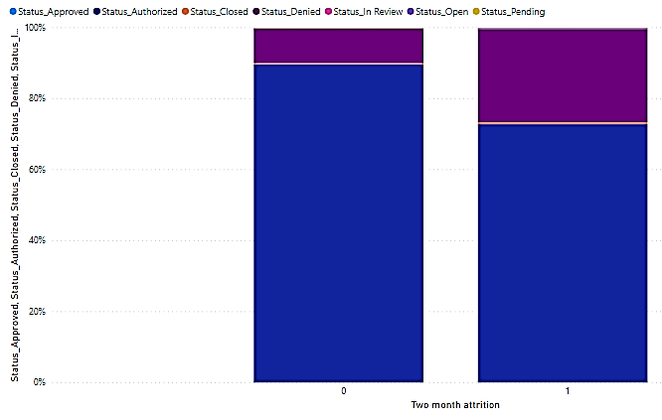
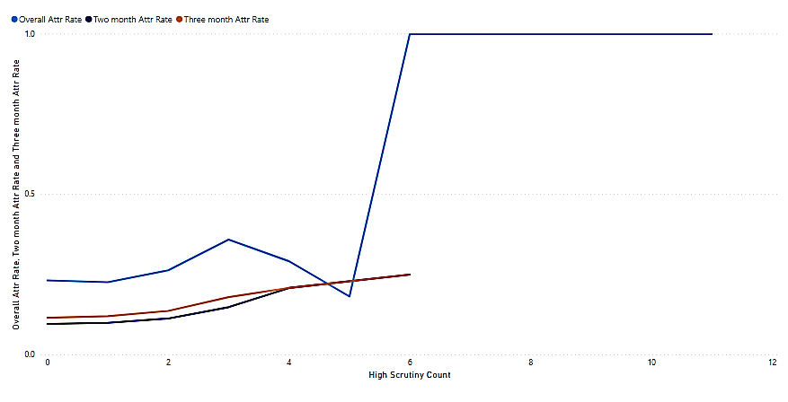
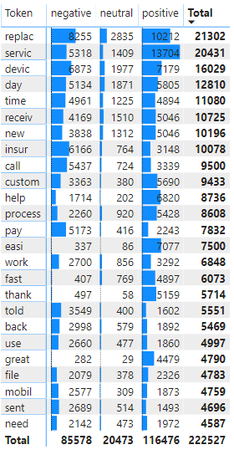
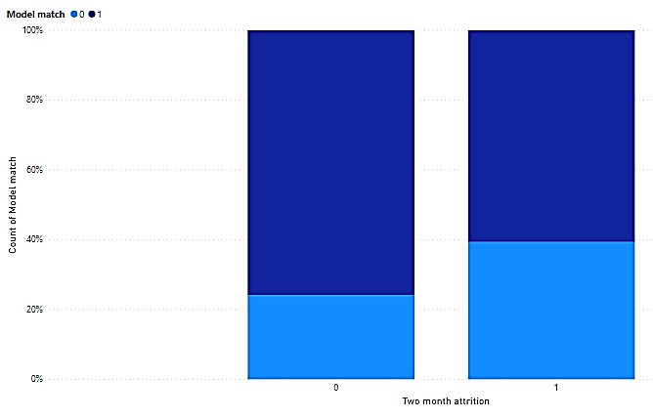
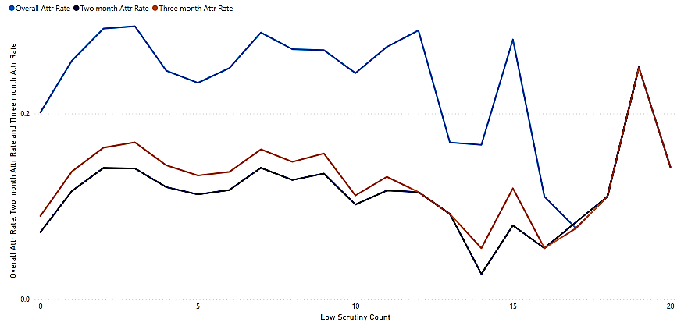
Data Characteristics
Notes:
Top left (claim status)
shows that customers who get their claim denied tend to leave relatively more often than those who
get their claim authorized.
Bottom left (model match)
indicates the same observation for customers who receive a replacement device that does not match their claimed device.
_____________________________
Visuals that describe how the attrition rate varies by the number of high and low scrutiny issues on
a claim.
Top right
shows how the approximate attrition rate varies by different issue counts of high scrutiny on claims.
One can see that for claims that have 6 or more issues of high scrutiny, all customers end up leaving.
Bottom right
displays the same concept but for low scrutiny issues on claims. For claims with under 10 issues of low scrunity, the attrition rate is under 0.2 which is lower than than the same under of issues but for high scrutiny.
_______________________________________________
Far right
Sentiment categories for Top 25 tokens from Question 2.
The sentiment score of the responses
showed that the majority are neutral and the tokens most associated with positive and negative sentiment is:
service, replacement, device, easy, help, and day.

Slide 8
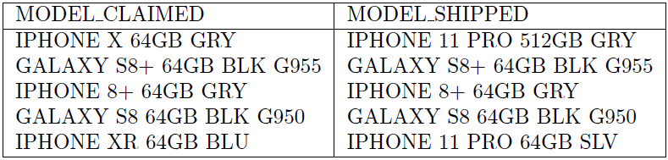
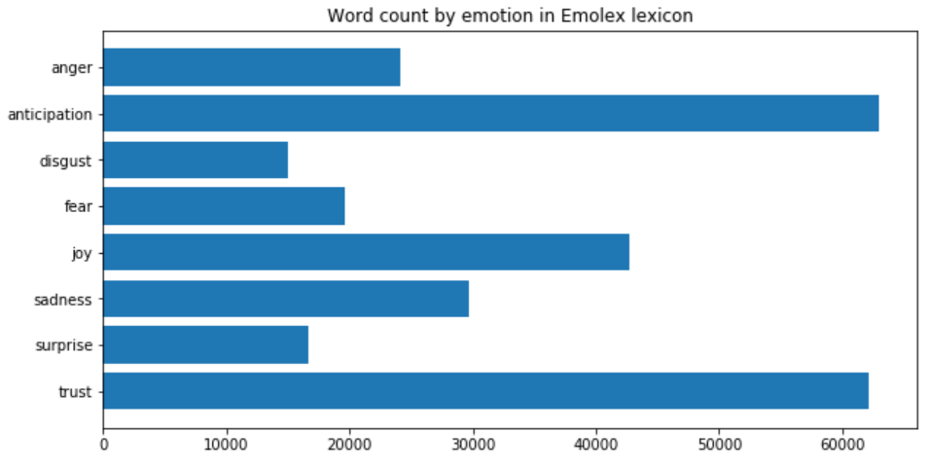
Feature Engineering
High/low scrutiny buckets
Model, color, and capacity match features
Demographics
Features from text
Sentiment scores (VADER)
Emotion scores
Notes:
the different types of scrutiny counts were combined into two categories, high and low scrutiny,
by summing up certain scrutiny countfi elds. This was done because the individual elds did not have much
variation across the target variables and were sparse.
The scrutiny counts were summed up by issue type, and
each issue type is associated with a severity level, which is a number between 1 and 9. The issue types in
descending order of severity are: Affidavit, SIU Review, Proof of Loss (POL) CRB Review, Original Invoice,
Police Report, POL Only, Customer Authorization, ePrism Issue, and None.
______________________________________________________________________________________________________________
Model, color, and capacity match
a function was created which calculates the stan-
dard Levenshtein distance similarity ratio between two strings. A threshold of 0.8 was set to distinguish a match
from a non-match. For the color match feature, the color had to be extracted from the MODEL CLAIMED and
MODE SHIPPED elds. Table 3 shows that the colors are inconsistently abbreviated, and there is no consistent
location for the color to be in within the string. The solution was to conduct a fuzzy match using a regular
expression (regex) pattern [3]. Each record gets searched on a regex pattern pertaining to each color on the list.
The fuzzy regex search was set to permit at most 2 errors of any type (insertion, deletion, or substitution) when
nding a match, since the colors within the strings are abbreviated)
____________________________
Demographics:
,[POPULATION_GROWTH]
,[HOUSEHOLDER_MEDIAN_AGE]
,[HOUSING_MEDIAN_RENT]
,[HOUSING_MEDIAN_VALUE_OWNER_HOUSEHOLDS]
,[HOUSEHOLDS_MEDIAN_VEHICLES]
,[HOUSEHOLD_INCOME_MEDIAN]
,[HOUSEHOLD_INCOME_PER_CAPITA]
,[POPULATION_MEDIAN_AGE]
,[HH_INCOME_200K_PLUS]
,[HOUSEHOLD_INCOME_HIGH_INCOME_AVERAGE]
,[RENTER_OCCUPIED_HOUSEHOLDS_PERCENT]
,[WHITE_POPULATION_ALONE_PERCENT]
,[OWNER_OCCUPIED_HOUSEHOLDS_PERCENT]
,[BLACK_POPULATION_ALONE_PERCENT]
,[ASIAN_PACIFIC_ISLANDER_POPULATION_ALONE_PERCENT]
,[AMERICAN_INDIAN_AND_ALASKA_NATIVE_POPULATION_ALONE_PERCENT]
,[OTHER_RACE_POPULATION_ALONE_PERCENT]
,[TWO_OR_MORE_RACES_POPULATION_PERCENT]
,[HISPANIC_POPULATION_PERCENT]
,[WHITE_NON_HISPANIC_POPULATION_PERCENT]
,[GRADUATE_DEGREE__PERCENT]
,[WHITE_COLLAR_EMPLOYMENT]
_______________________________
Sentiment scores – compound score from VADER tool
Lexicons
The NRC Emotion Lexicon, or
Emolex, is a list of words and their associations with eight emotions: anger, fear, anticipation, trust, surprise,
sadness, joy, and disgust
NRC Valence, Arousal, and Dominance (VAD) Lexicon is a list of words and their valence, arousal, and
dominance scores
NRC Emotion Intensity Lexicon (Aect Intensity Lexicon) is a list of 6,000 words and their intensity
scores for four emotions: anger, fear, sadness, and joy
*for the last two, took the average of the score for each record/response
__________________________________________________________________
The High Scrutiny Count feature
was created by summing up the counts for Adavit, SIU Review, POL CRB Review, Original Invoice, and
Police Report. Low Scrutiny Count is comprised of the remaining columns: POL Only, Customer Authorization,
and ePrism Open Issue.

Slide 9
Models
Structured
Claim details, demographics, sentiment, emotions features
Text
Pre-trained embedding
Combined
Included top TF-IDF features
Word2vec embedding trained on data
Ensemble
TF-IDF
LSTM
Simple architecture
ReLu activation; Adam optimizer and binary cross-entropy loss.
Notes:
A recurrent neural network was used to model attrition from customer-level claim events. The data was
a multiple input series where each row is a time step and containing multiple inputs and one output parallel
series. For a LSTM model, the data was transformed into input/output samples, based on a xed time step
size. As a result some data had to be discarded which didn't t the time step size. The transformed input
data is in a three-dimensional structure (number of samples, number of time steps per sample, and number of
variables). A simple LSTM architecture was used (input, LSTM layer, output) with a ReLu activation, Adam
optimizer and binary cross-entropy loss.

Slide 10
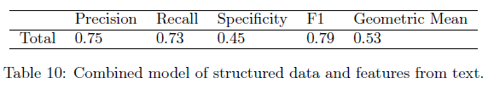
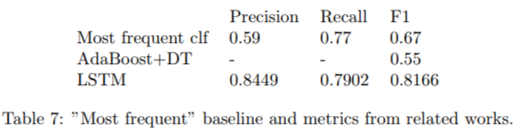
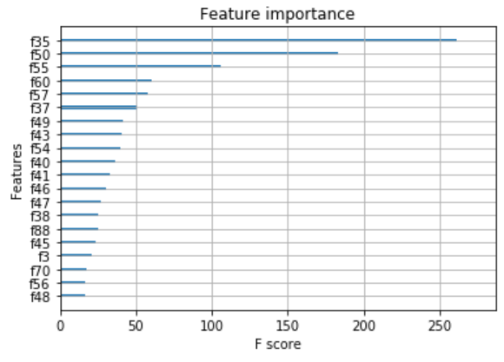
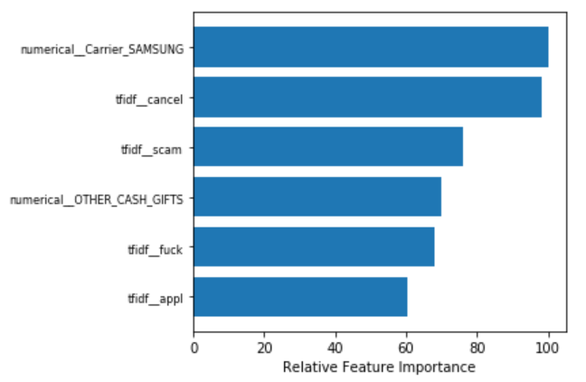
Results
Answer 1
Loss = physical damage
Non-new replacement device
Deductible amount
Carrier is Samsung or T-Mobile
Other: low scrutiny count, and total claim time
TF-IDF terms: cancel, scam, f***, apple
Notes:
Feature importance based on gain measurement
Gain implies the relative contribution of the corresponding feature to the model calculated by taking each feature's contribution for each tree in the model. A higher value of this metric when compared to another feature implies it is more important for generating a prediction.
Other* is based on weight - weight” is the number of times a feature appears in a tree (same as frequency)

Slide 11
Contributions
Contributed a developed model
An augmented key driver analysis for attrition which includes external data sources and significant TF-IDF terms
Model did not achieve start of art F1 score but is better than the most frequent baseline
Important features can be used to make recommendations to the claims operations and customer experience teams on how to improve and prevent attrition
Further work can entail working on carrier-specific models and rule-based methods for driving customer continuity management
Notes:
Attrition is a metric that is tracked and reported on, but there is no scoring of customers for attrition likelihood.

